Slide 1
R introduction II
Chi Zhang
19/05/2014

Slide 2
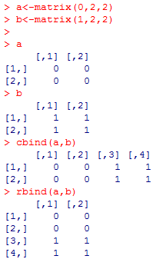
Data combining
cbind
Combine data by column
rbind
Combine data by row
Eg.
a<-matrix(0,2,2)
b<-matrix(1,2,2)
cbind(a,b)
rbind(a,b)

Slide 3

length
a<-c(1:5)
length(a)

Slide 4
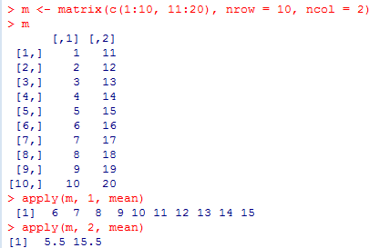
apply
Apply Functions Over Array Margins
apply(DATA, MARGIN, FUNCTION, ...)
MARGIN= 1 for rows; 2 for columns
Eg.
m <- matrix(c(1:10, 11:20), nrow = 10, ncol = 2)
apply(m, 1, mean)
apply(m, 2, mean)

Slide 5
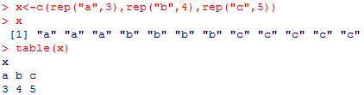
Table
build a contingency table of the counts
Eg
x<-c(rep("a",3),rep("b",4),rep("c",5))
x
table(x)

Slide 6
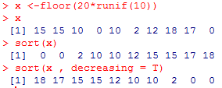
Sort and Unique
Sorting a vector
sort(x, decreasing = FALSE)
Eg
x <-floor(10*runif(10))
sort(x)
sort(x , decreasing = T)
Unique, remove duplicated elements
Eg
unique(sort(x))

Slide 7
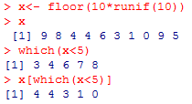
Subsetting data
Which command
which(****),**** should be a logical operation
which(****), return the index of TRUE elements in the logical operation
Eg
x<- floor(10*runif(10))
x
which(x<5)
x[which(x<5)]

Slide 8
For loop
For loop:
http://en.wikipedia.org/wiki/For_loop
In computer science a for loop is a programming language statement which allows code to be repeatedly executed
Question:
Calculate the sum of all the values in the vector x<- floor(10*runif(10))

Slide 9
For loop
Real computer program!
Eg.
for(i in 1:100){
print("Hello world!")
print(i*i)
}

Slide 10
For loop
for(*** in ***){}
for(VARIABLE in TARGETSET){}
for(i in 1:100){}
x <-floor(10*runif(10))
total_x<-0
for(i in 1:length(x))
{
print(i)
print(x[i])
total_x<-total_x+x[i]
}

Slide 11
A real case
We have analyzed the clinical data of TCGA colon adenocarcinoma samples in the first home work.
Now I want to extract the clinical data of all the stage I and stage II patients
Use the commands in this lecture

Slide 12
Idea
Load the clinical data
Find the stage information
Extract the stage I and stage II samples
A problem: the samples’ stage information may be Stage IA, Stage IIC, etc… how to extract?
Try for loop to extract samples of each category (like all Stage IA samples)
Then combine the extracted data

Slide 13
R code
rm(list=ls())
list.files()
data_clinical<-read.csv("COADclinical_patient.csv")
data_clinical$pathologic_stage<-as.character(data_clinical$pathologic_stage)
head(data_clinical)
table(data_clinical$pathologic_stage)
all_stages<-unique(sort(data_clinical$pathologic_stage))
all_I_II_stages<-all_stages[c(2,3,4,5,6,7)]
all_I_II_stages<-c("Stage I","Stage IA","Stage II","Stage IIA","Stage IIB","Stage IIC")
data_stage_I_II<-c()
for(i in 1:length(all_I_II_stages))
{
id<-which(data_clinical$pathologic_stage==all_I_II_stages[i])
data_stage_I_II<-rbind(data_stage_I_II,data_clinical[id,])
}

